Slide 1
CSE315:Introduction to Data Science
WEEK-1

Slide 2
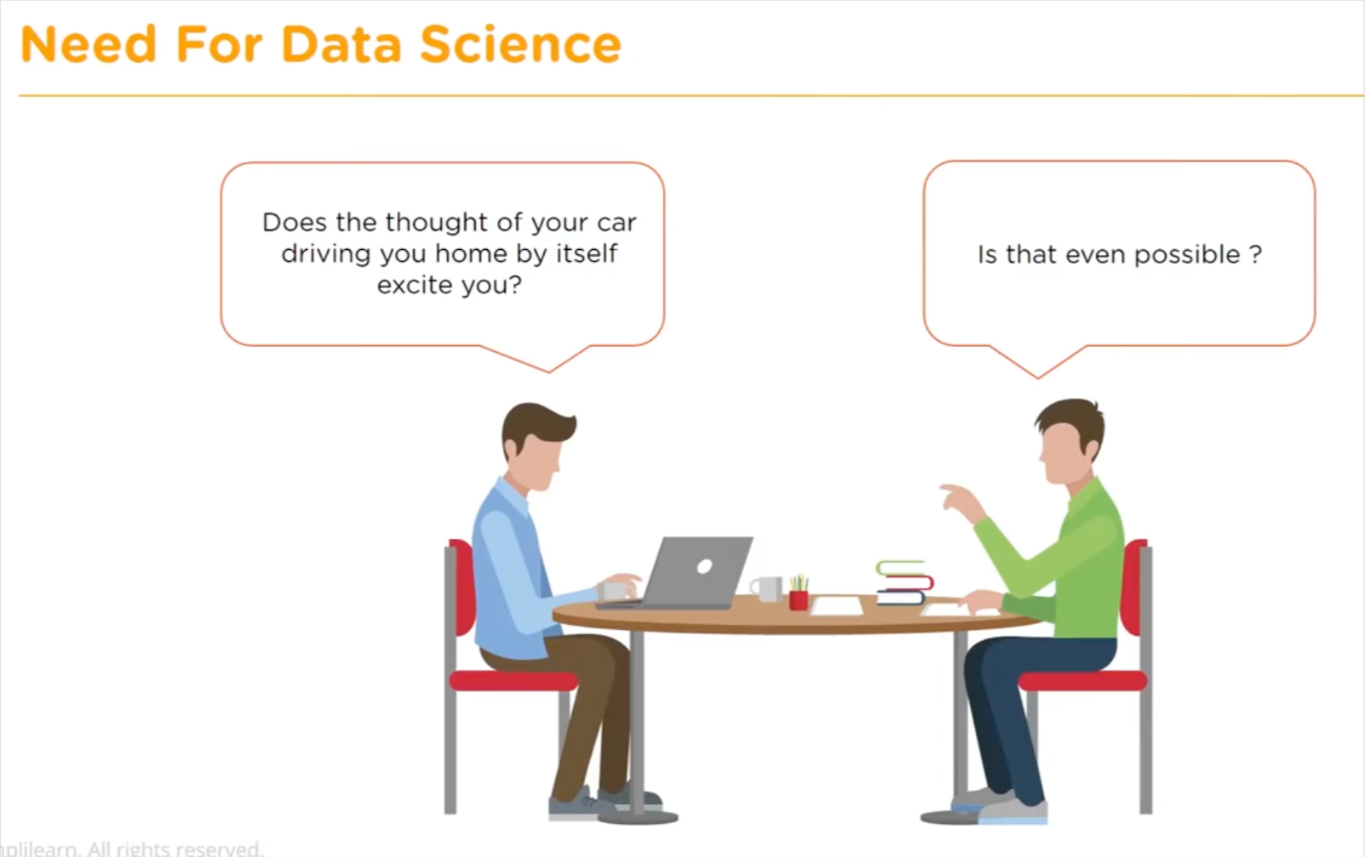

Slide 3
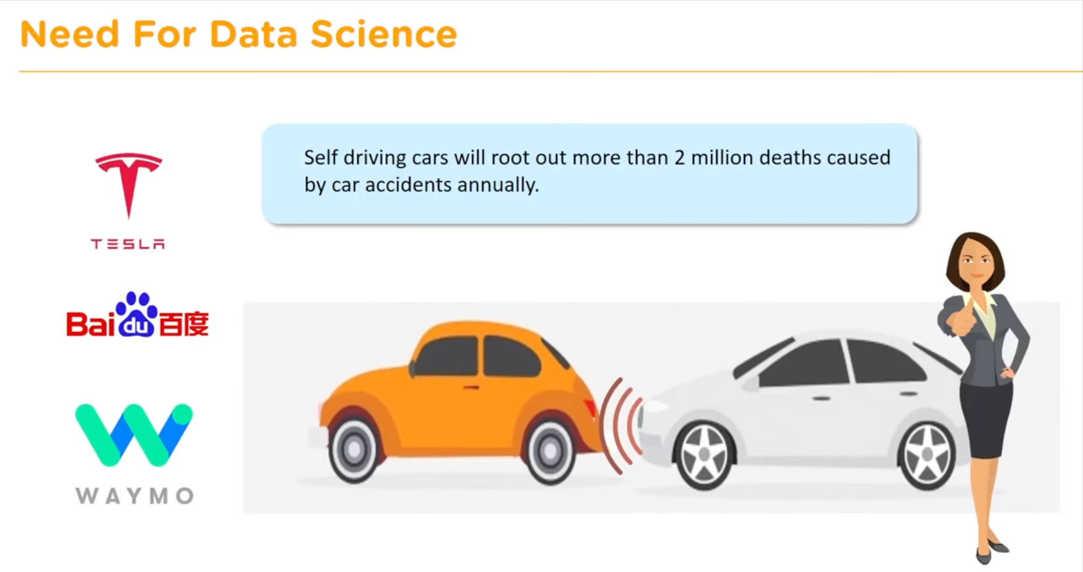

Slide 4
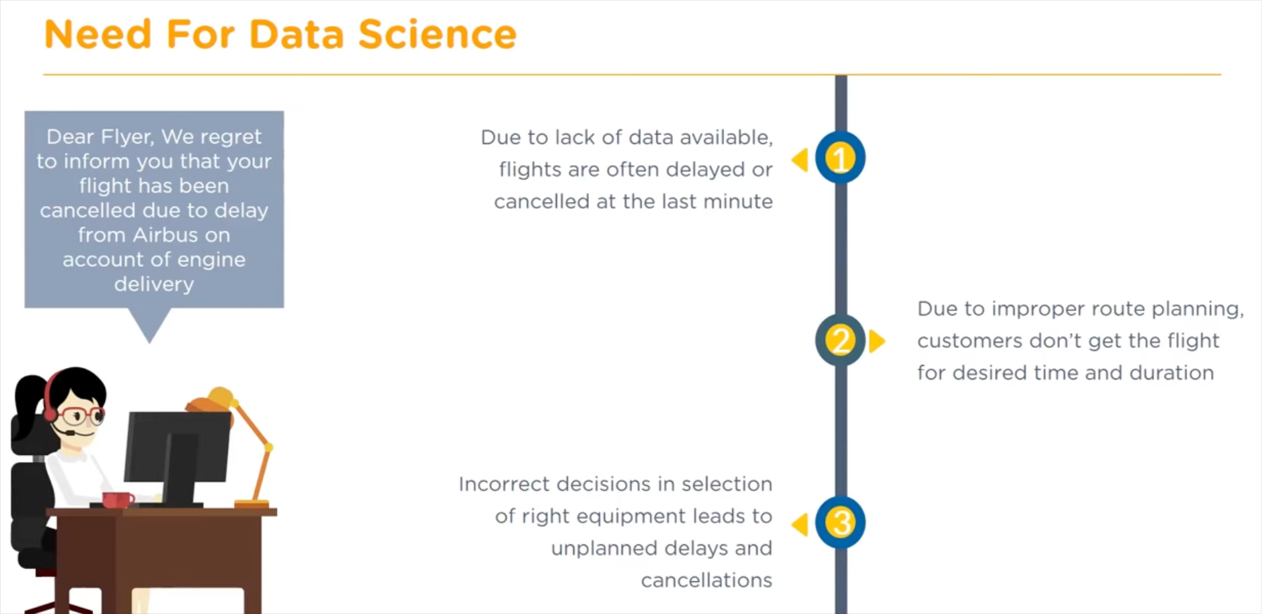

Slide 5
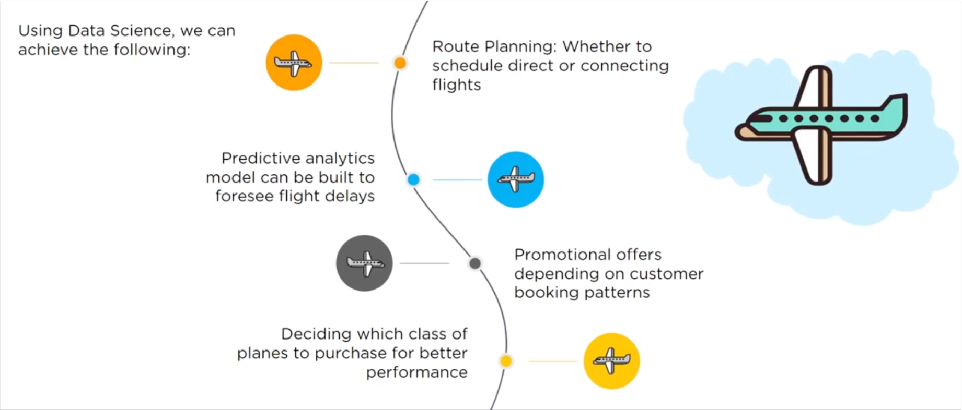
Need for data Science

Slide 6
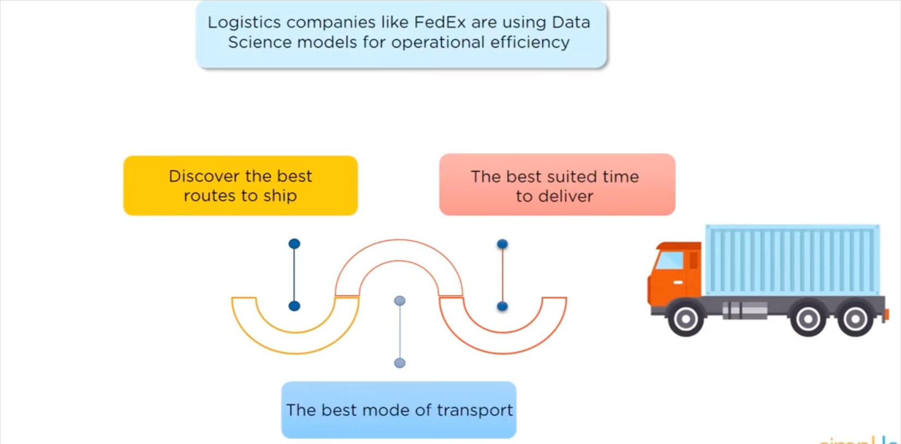

Slide 7
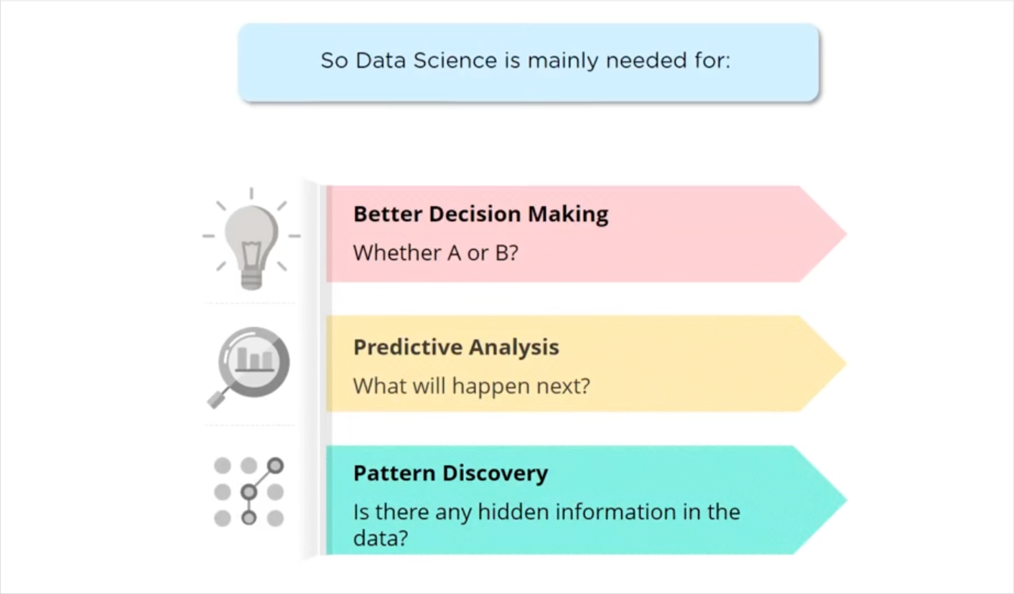

Slide 8

Need for data Science

Slide 9
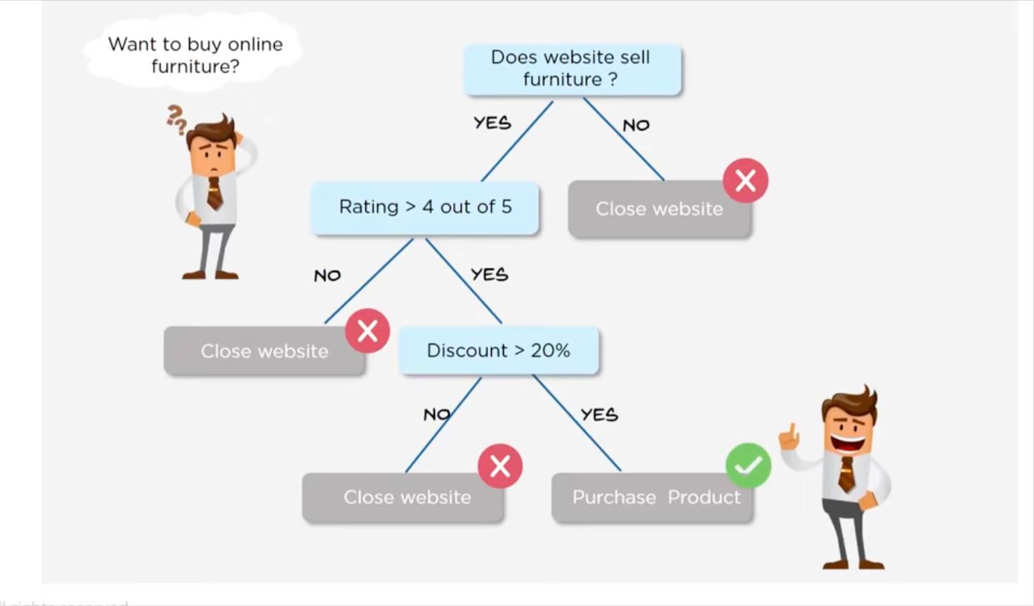

Slide 10
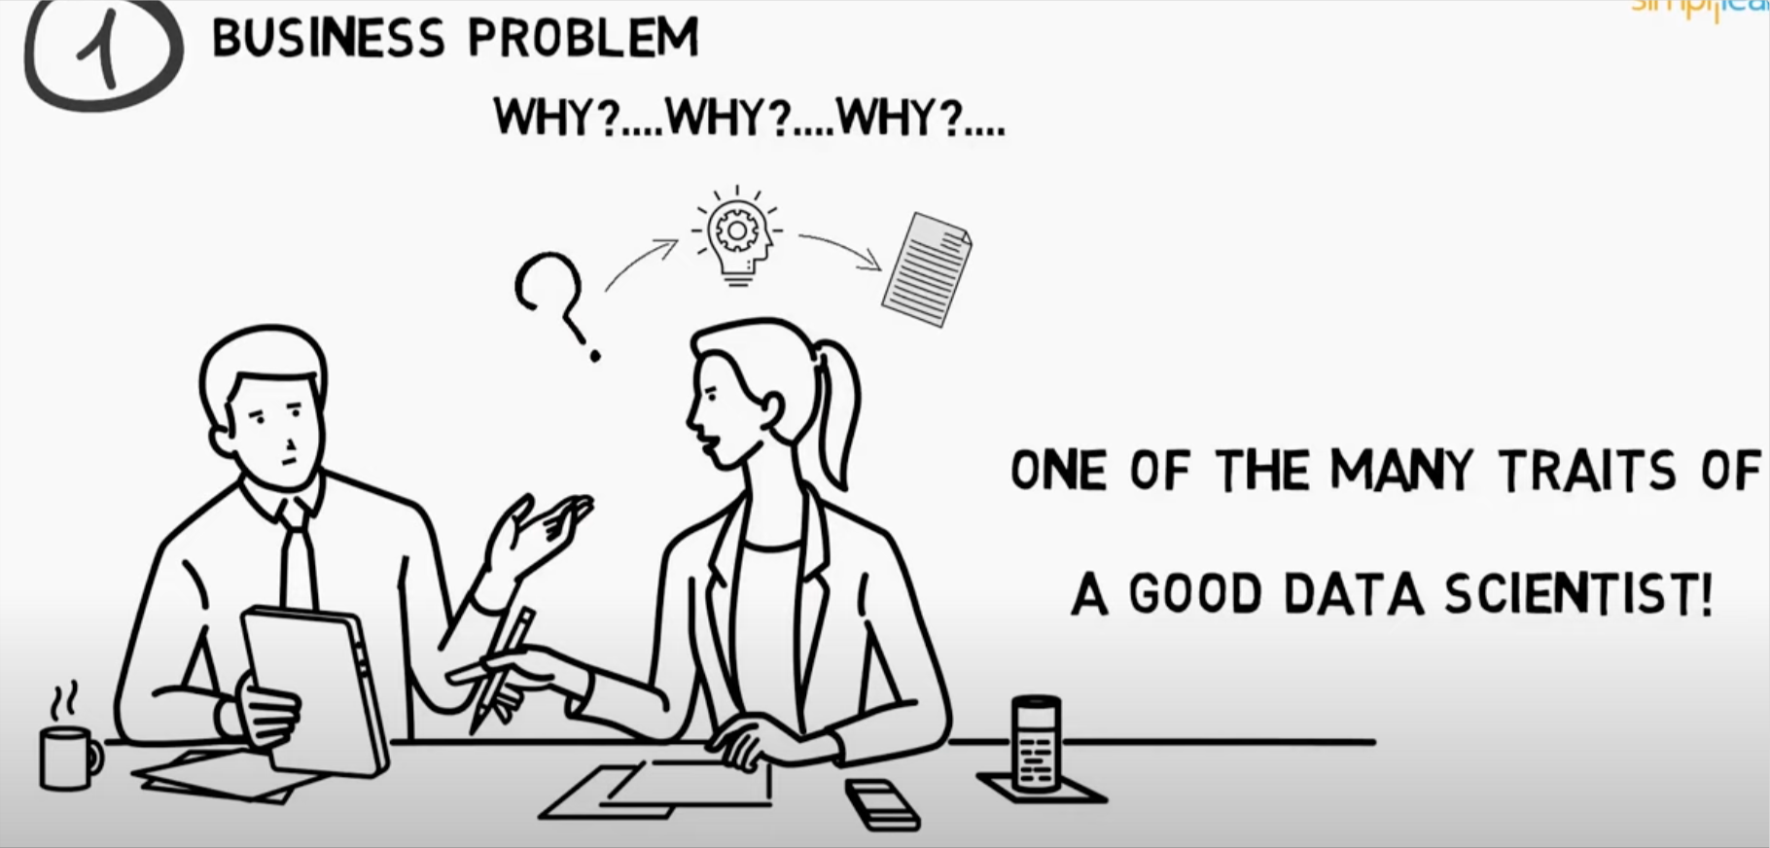
Steps involved in Data Science

Slide 11
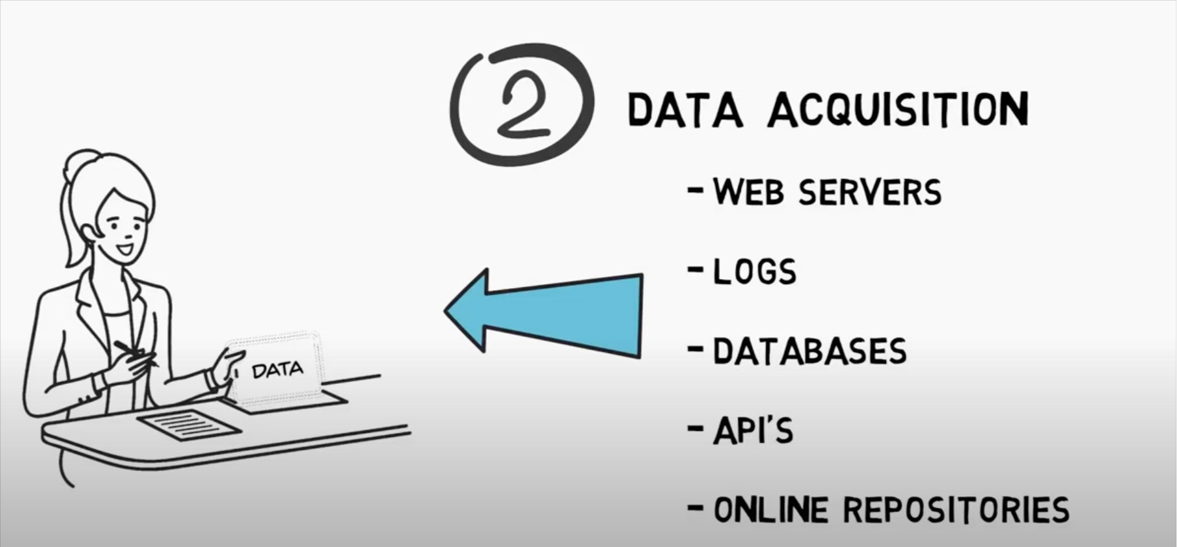
Steps involved in Data Science

Slide 12
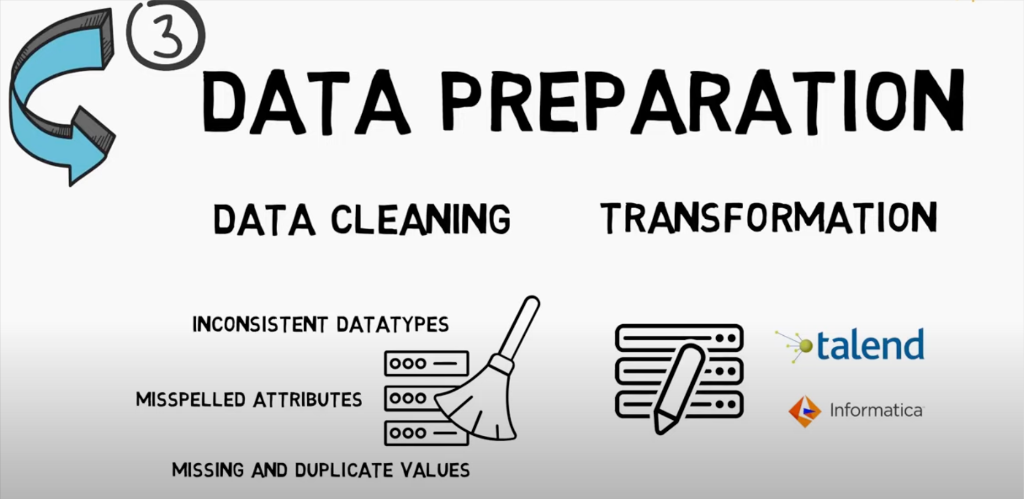
Steps involved in Data Science

Slide 13
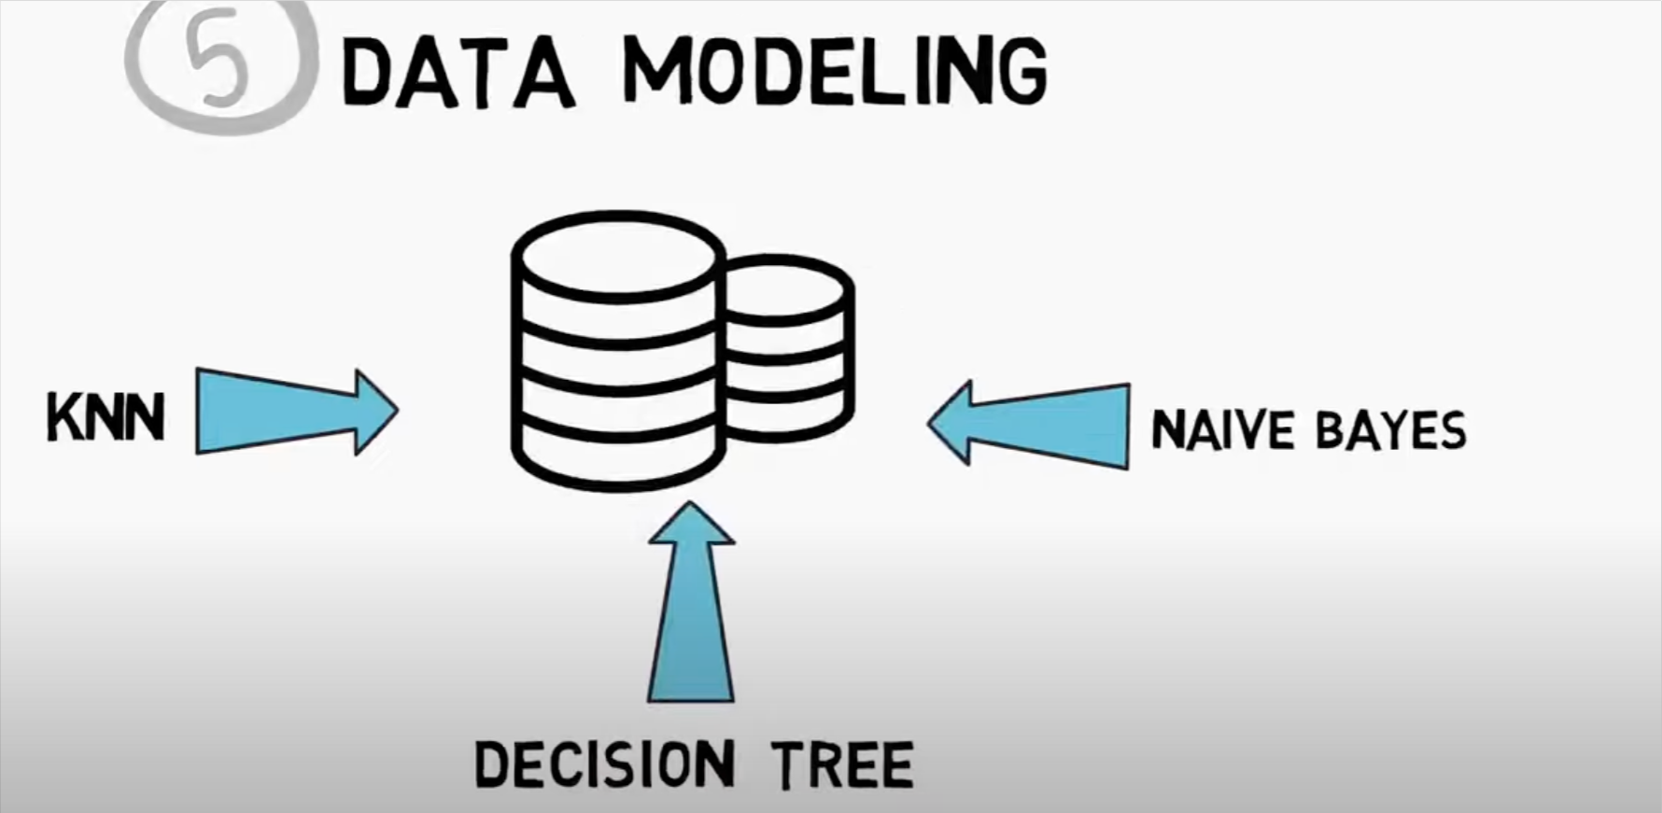
Steps involved in Data Science

Slide 14
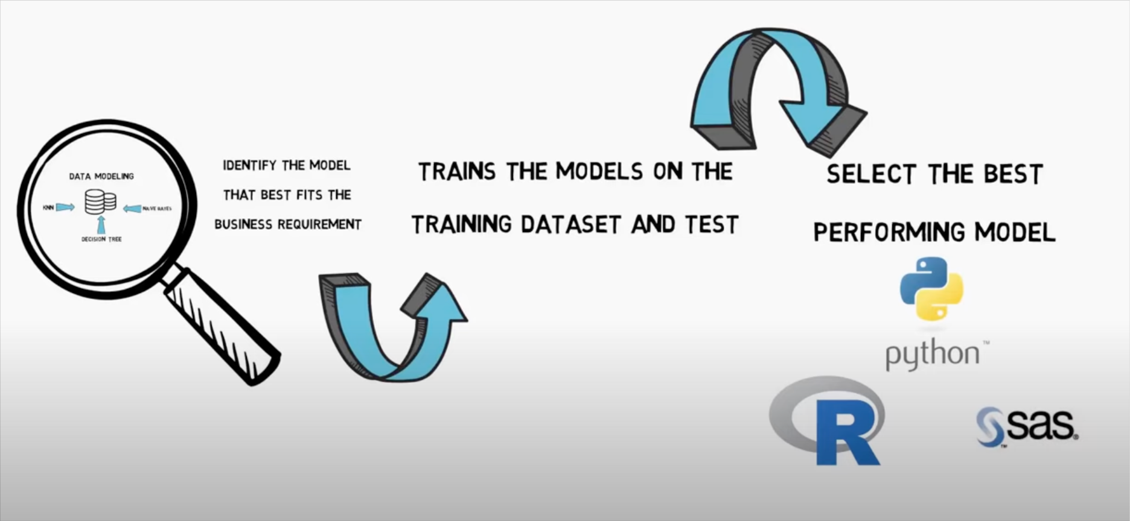
Steps involved in Data Science

Slide 15
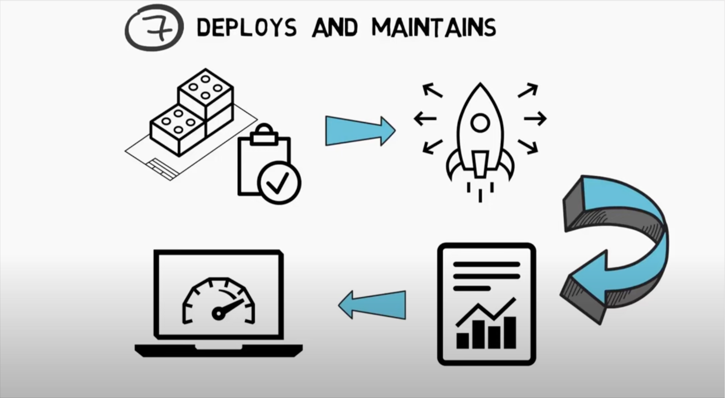
Steps involved in Data Science

Slide 16
Data Science
Data science is a collection of techniques used to extract value from data. It has become an essential tool for any organization that collects, stores, and processes data as part of its operations.
Data science techniques rely on finding useful patterns, connections, and relationships within data. Being a buzzword, there is a wide variety of definitions and criteria for what constitutes data science.
Data science is also commonly referred to as knowledge discovery, machine learning, predictive analytics, and data mining.

Slide 17
Data Science
Data science starts with data, which can range from a simple array of a few numeric observations to a complex matrix of millions of observations with thousands of variables.
Data science utilizes certain specialized computational methods in order to discover meaningful and useful structures within a dataset.
The discipline of data science coexists and is closely associated with a number of related areas such as database systems, data engineering, visualization, data analysis, experimentation, and business intelligence (BI).

Slide 18
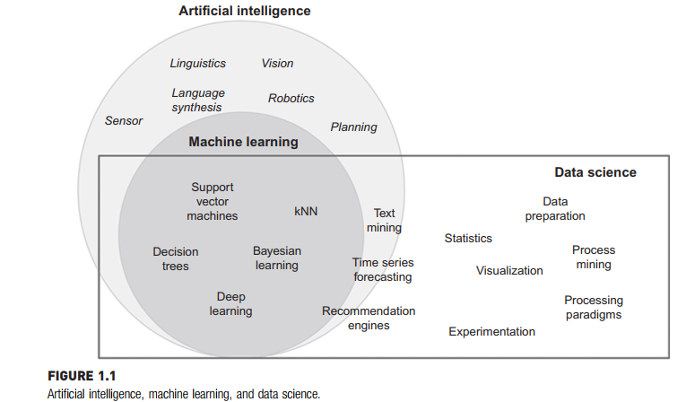
AI, ML and Data Science

Slide 19
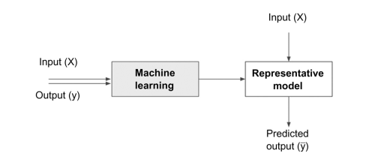
Data Science Models

Slide 20
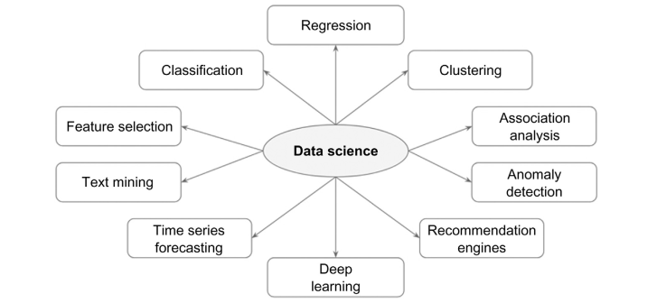
Data Science Tasks

Slide 21
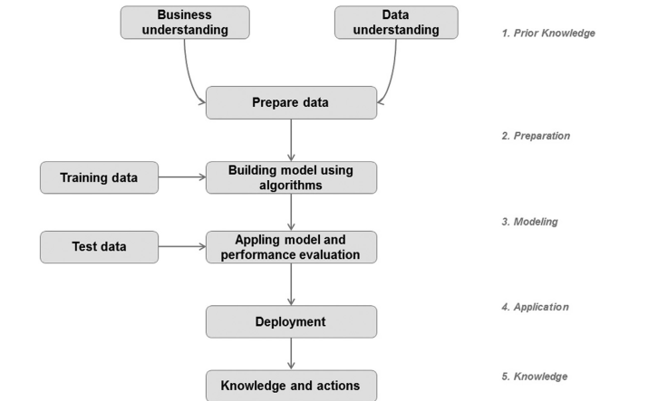
Data Science Process

Slide 22
Objectives of Data Science
The data science process starts with a need for analysis, a question, or a business objective. This is possibly the most important step in the data science process (Shearer, 2000).
Without a well-defined statement of the problem, it is impossible to come up with the right dataset and pick the right data science algorithm. As an iterative process, it is common to go back to previous data science process steps, revise the assumptions, approach, and tactics.

